Slide 1
Listening Skills
Dept. Of HSS, JIIT, Noida

Slide 2
Content to be Covered
What will we learn today?
Know about Skills of Language Learning & their Inter-relation.
Listening & how it is different from Hearing.
Process of Listening.
Purpose of Listening.
Types of Listening.
Barriers to Listening
Tips for Active Listening.
Resources to be consulted for further reading:
Chaturvedi. P.D ( 2011). Business Communication: Concepts, Cases, and Applications, Second edition, Pearson Education India.
Its online availability site: https://docs.google.com/viewer?a=v&pid=sites&srcid=ZGVmYXVsdGRvbWFpbnxvbGVya2RyZXN8Z3g6MjU4MTc4NTNmMTdjMWVjNg
Rizvi, A. R. ( 2018) ‘Effective Technical Communication’ 2nd edition, McGraw Hill Education Private Limited, Chennai.

Slide 3
What are the Skills Required for Learning Any Language???
Language
Listening
Speaking
Reading
Writing

Slide 4
Inter-relation of Skills
Listening & Speaking are Aural-Oral Skills.
Reading & Writing are Graphio-Motor Skills.
Listening & Reading are input oriented, hence Receptive Skills.
Speaking & Writing are output oriented, hence productive skills.
But!!!
WITHOUT INPUT, there cannot be OUTPUT.
Hence listening is key to mastering any language.

Slide 5
What is Listening?
Listening is a physical and psychological process that involves acquiring, assigning meaning, and responding to symbolic messages from others.
So!!!
Listening involves understanding spoken as well as unspoken words, pauses, gaps….

Slide 6
Difference between Listening & Hearing
Hearing is the reception of sound, while listening is the attachment of meaning to the sound.
Hearing is passive, but listening is active.

Slide 7
Process of Listening
Acquiring
Acquiring is the act of picking up some type of stimulus through the senses, such as hearing.
Understanding
Understanding is a complex mental process that involves decoding the symbolic message received from others and then interpreting and assigning personal meaning to that message.
Responding
Responding is important to clarify and convey to the speaker that you are listening.
Attending
Attending is the act of choosing, consciously or subconsciously, to focus your attention on verbal or nonverbal stimuli.

Slide 8
Purposes of Listening
For Information
For Enjoyment/Pleasure
To follow instructions or directions.
To evaluate
To solve problems
For social communication.
Purpose defines our way and form of listening:
Active v/s passive form or social v/s critical form.

Slide 9
Types of Listening
Superficial Listening
Appreciative Listening
Focused Listening
Evaluative / Critical Listening
Attentive Listening
Empathic Listening

Slide 10
General Barriers to Listening: Speaker Oriented & Listener Oriented
Physical Barriers
Psychological Barriers
Linguistic Barriers
Cultural Barriers

Slide 11
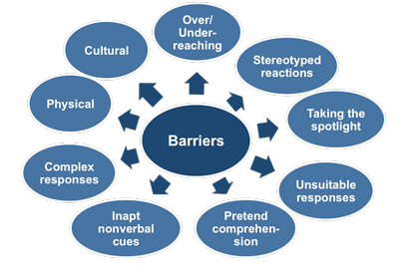
Knowing More Complex Barriers to Listening

Slide 12
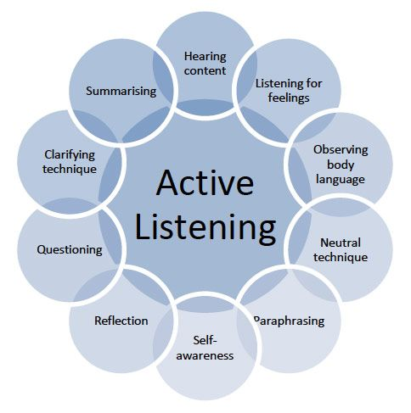
Tips for Active Listening

Slide 13
Learnings
Nurturing good Listening Skills will make us better in Communication.
Listening creates understanding.
It is key to coordination in any team work and collaboration.
Listening to gaps, pauses and intonation helps in empathising with speaker.
If speaking is silver, then listening is gold.
–Turkish proverb

Slide 14
Relevance
Enhances Communication skills.
Helps in establishing productive relationship.
Makes us empathic.
Inculcates sense of understanding.
Develops our concentration power.
Makes us good team-mate.
Nurtures healthy environment devoid of miscommunication or egoistic issues at workplace.

Slide 15
A Big Thanks!!!!
Thank you for listening to me!

Slide 16
Now Let’s Revise...
1) Hearing is _passive________while Listening is ____active___
2) Name the Aural-Oral Skills. Listening n speaking
3) What is the first process of listening? aquiring
4) Pretending comprehension comes under which category of Barrier to Listening?
Physical
Psychological
Linguistic
Cultural
5) Superficial Listening falls under which form of listening?
Active
Passive
Social
Critical

Slide 17
References
Mohanraj, J. (2015) ‘Let Us Hear Them Speak’: developing Speaking Listening Skills in English, Sage Texts, New Delhi.
Rizvi, A. R. ( 2018) ‘Effective Technical Communication’ 2nd edition, McGraw Hill Education Private Limited, Chennai.
Raman, M. & S. Sharma.( 2009) ‘Technical Communication: Principles & Practices’, 29th Impression, Oxford University Press, New Delhi.

Slide 18
Image Sources
https://www.google.com/url?sa=i&url=https%3A%2F%2Fwww.govloop.com%2Fcommunity%2Fblog%2Fhiring-social-media-digital-expertise-hierarchy%2F&psig=AOvVaw1ldojxXcFMYnbXVXuP5Yb5&ust=1597988457485000&source=images&cd=vfe&ved=0CBoQtaYDahcKEwjAwJuQianrAhUAAAAAHQAAAAAQBg
https://www.google.com/url?sa=i&url=https%3A%2F%2Fwww.dreamstime.com%2Fwoman-attending-listening-beautiful-brunette-young-head-hands-thinking-image107319116&psig=AOvVaw3mKfDwf_OOzFYn7jUltF5P&ust=1597988604373000&source=images&cd=vfe&ved=0CAMQjB1qFwoTCLi62_SJqesCFQAAAAAdAAAAABAR
https://www.google.com/url?sa=i&url=https%3A%2F%2Fwww.wikihow.com%2FAccept-Constructive-Criticism&psig=AOvVaw2H_hSXLWXmpjvLMe8kse8T&ust=1597990807042000&source=images&cd=vfe&ved=0CAQQtaYDahcKEwiwj5GDkqnrAhUAAAAAHQAAAAAQDQ
https://www.google.com/url?sa=i&url=https%3A%2F%2Fwww.ausmed.com%2Fcpd%2Fguides%2Fcommunication-skills&psig=AOvVaw0MDhUCYIX8wbRpCJkSlnWM&ust=1597991398504000&source=images&cd=vfe&ved=0CJgBEK-JA2oXChMIkJHNj5Sp6wIVAAAAAB0AAAAAEAQ
https://www.google.com/url?sa=i&url=http%3A%2F%2Fwww.free-management-ebooks.com%2Ffaqcm%2Factive-05.htm&psig=AOvVaw33njEP0lUvhhjaQ4f-6Qcd&ust=1597993701550000&source=images&cd=vfe&ved=0CAMQjB1qFwoTCND-382cqesCFQAAAAAdAAAAABAD
https://www.google.com/url?sa=i&url=https%3A%2F%2Fwww.pinterest.com%2Fpin%2F551761391845346284%2F&psig=AOvVaw3V1GR0y24VAKDehssxfI-u&ust=1597994280616000&source=images&cd=vfe&ved=0CAMQjB1qFwoTCICjs-yeqesCFQAAAAAdAAAAABAt

